Slide 1
Software Development Lifecycle
Introduction to SDLC

Slide 2
Agenda slide, 24p, effra medium
01
Introduction to SDLC
02
Phases of SDLC
03
Planning, Analysis, Design Phase
04
Implementation, Testing, Deployment Phase
05
Maintenance Phase

Slide 3
01
Introduction to SDLC
What is SDLC

Slide 4
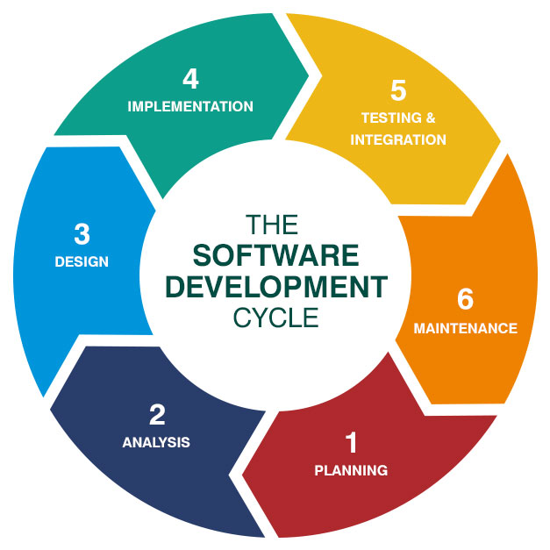
What is SDLC
Definition of SDLC
Importance of SDLC in software development
The different phases of SDLC
Notes:
This course is designed to introduce you to Scripting concepts and techniques that are relevant to DevOps. By the end of the course, you'll have a better understanding of how Scripting supports DevOps principles like automation, collaboration, and continuous improvement. So, in this course, we'll focus on how to use Scripting to support DevOps practices and principles. By the end of the course, you should be able to write scripts that automate common DevOps tasks, like provisioning infrastructure, configuring servers, deploying applications, and monitoring systems.

Slide 5
02
Phases of SDLC
Splitting the process

Slide 6
Phases of SDLC
Planning
Analysis
Design
Implementation
Testing
Deployment
Maintenance
Notes:
First, let's define what we mean by Scripting. Scripting is the process of writing a sequence of instructions that a computer can execute to automate a task. These instructions are typically written in a Scripting language like Python, PowerShell, or Bash.
Now, let's explore why Scripting is important in DevOps. DevOps is all about delivering software faster, with higher quality, and at lower cost. Scripting supports these goals by enabling automation, which reduces errors, increases speed, and promotes collaboration. With Scripting, DevOps teams can automate common tasks like provisioning infrastructure, configuring servers, deploying applications, and monitoring systems. This allows them to focus on higher-value tasks, like improving the software itself, and to deliver software more quickly and reliably.
Finally, let's look at how Scripting supports DevOps principles like automation, collaboration, and continuous improvement. Automation is a key principle of DevOps, and Scripting is the tool that makes it possible. With Scripting, DevOps teams can automate repetitive and error-prone tasks, which reduces the risk of human error and frees up time for more valuable work.

Slide 7
03
Planning, Analysis, Design Phase
Scope, stakeholders, architecture

Slide 8

Planning, Analysis, Design Phase
These three phases often overlap and are closely connected
They are focused on understanding the problem and defining the solution
Notes:
In this slide, we'll cover some basic Scripting concepts that are essential for writing scripts in any language. These concepts will form the building blocks for the more advanced Scripting topics we'll cover in the later slides.

Slide 9
Planning Phase
Define project scope and objectives
Identify project stakeholders
Develop project timelines and budgets
Develop project plans and strategies
Notes:
In this slide, we'll cover some basic Scripting concepts that are essential for writing scripts in any language. These concepts will form the building blocks for the more advanced Scripting topics we'll cover in the later slides.

Slide 10
Analysis Phase
Gather requirements from stakeholders
Conduct feasibility studies
Identify risks and constraints
Create user stories and use cases
Notes:
In this slide, we'll cover some basic Scripting concepts that are essential for writing scripts in any language. These concepts will form the building blocks for the more advanced Scripting topics we'll cover in the later slides.

Slide 11
Design Phase
Develop system and software architecture
Design user interfaces
Define data structures and algorithms
Create system specifications and design documents
Notes:
In this slide, we'll cover some basic Scripting concepts that are essential for writing scripts in any language. These concepts will form the building blocks for the more advanced Scripting topics we'll cover in the later slides.

Slide 12
Planning, Analysis, Design Phase -> Output
A clear understanding of the problem and the solution
A roadmap for the rest of the project
High-level design documents and specifications
These phases lay the foundation for the rest of the SDLC
A well-planned, well-analyzed, and well-designed system is more likely to meet stakeholder needs and be successful in the long-term
Notes:
In this slide, we'll cover some basic Scripting concepts that are essential for writing scripts in any language. These concepts will form the building blocks for the more advanced Scripting topics we'll cover in the later slides.

Slide 13
04
Implementation, Testing, Deployment Phase
Lets build some stuff

Slide 14

Implementation, Testing, Deployment Phase
These three phases are focused on building and launching the system
They are closely connected and often occur concurrently
Notes:
In this slide, we'll cover some basic Scripting concepts that are essential for writing scripts in any language. These concepts will form the building blocks for the more advanced Scripting topics we'll cover in the later slides.

Slide 15
Implementation Phase
Write and test code
Integrate software components
Create and maintain databases
Develop user documentation
Notes:
In this slide, we'll cover some basic Scripting concepts that are essential for writing scripts in any language. These concepts will form the building blocks for the more advanced Scripting topics we'll cover in the later slides.

Slide 16
Testing Phase
Create test cases and scenarios
Execute test cases and scenarios
Identify and report bugs and defects
Conduct user acceptance testing
Notes:
In this slide, we'll cover some basic Scripting concepts that are essential for writing scripts in any language. These concepts will form the building blocks for the more advanced Scripting topics we'll cover in the later slides.

Slide 17
Deployment Phase
Deploy software to production
Conduct final system testing
Create and distribute user manuals and training materials
Conduct user training sessions
Notes:
In this slide, we'll cover some basic Scripting concepts that are essential for writing scripts in any language. These concepts will form the building blocks for the more advanced Scripting topics we'll cover in the later slides.

Slide 18
Implementation, Testing, Deployment Phase --> output
A fully functional system that meets stakeholder needs
Comprehensive testing documentation and reports
User manuals and training materials
These phases are critical for ensuring that the system is launched successfully
Thorough testing and user training can prevent issues and improve user adoption
Effective deployment can minimize downtime and disruption for users
Notes:
In this slide, we'll cover some basic Scripting concepts that are essential for writing scripts in any language. These concepts will form the building blocks for the more advanced Scripting topics we'll cover in the later slides.

Slide 19
05
Maintenance Phase
Use what we build

Slide 20
Maintenance Phase
Identifying and fixing
Identifying and fixing bugs and defects
Enhancing
Enhancing software functionality
Updating
Updating system documentation
Retiring or replacing
Retiring or replacing outdated software
Notes:
In this slide, we'll cover some basic Scripting concepts that are essential for writing scripts in any language. These concepts will form the building blocks for the more advanced Scripting topics we'll cover in the later slides.

Slide 21

Conclusion
SDLC is a structured approach to software development that includes several phases.
The phases of SDLC include planning, analysis, design, implementation, testing, deployment, and maintenance.
Each phase has its own set of activities, outputs, and challenges.
SDLC helps ensure that software projects are well-planned, well-executed, and meet stakeholder needs.
A well-designed system is more likely to be successful and have a longer lifespan.
SDLC can also help reduce the risk of project failure, improve software quality, and increase user satisfaction.
Notes:
In this slide, we'll cover some basic Scripting concepts that are essential for writing scripts in any language. These concepts will form the building blocks for the more advanced Scripting topics we'll cover in the later slides.

